Slide 1
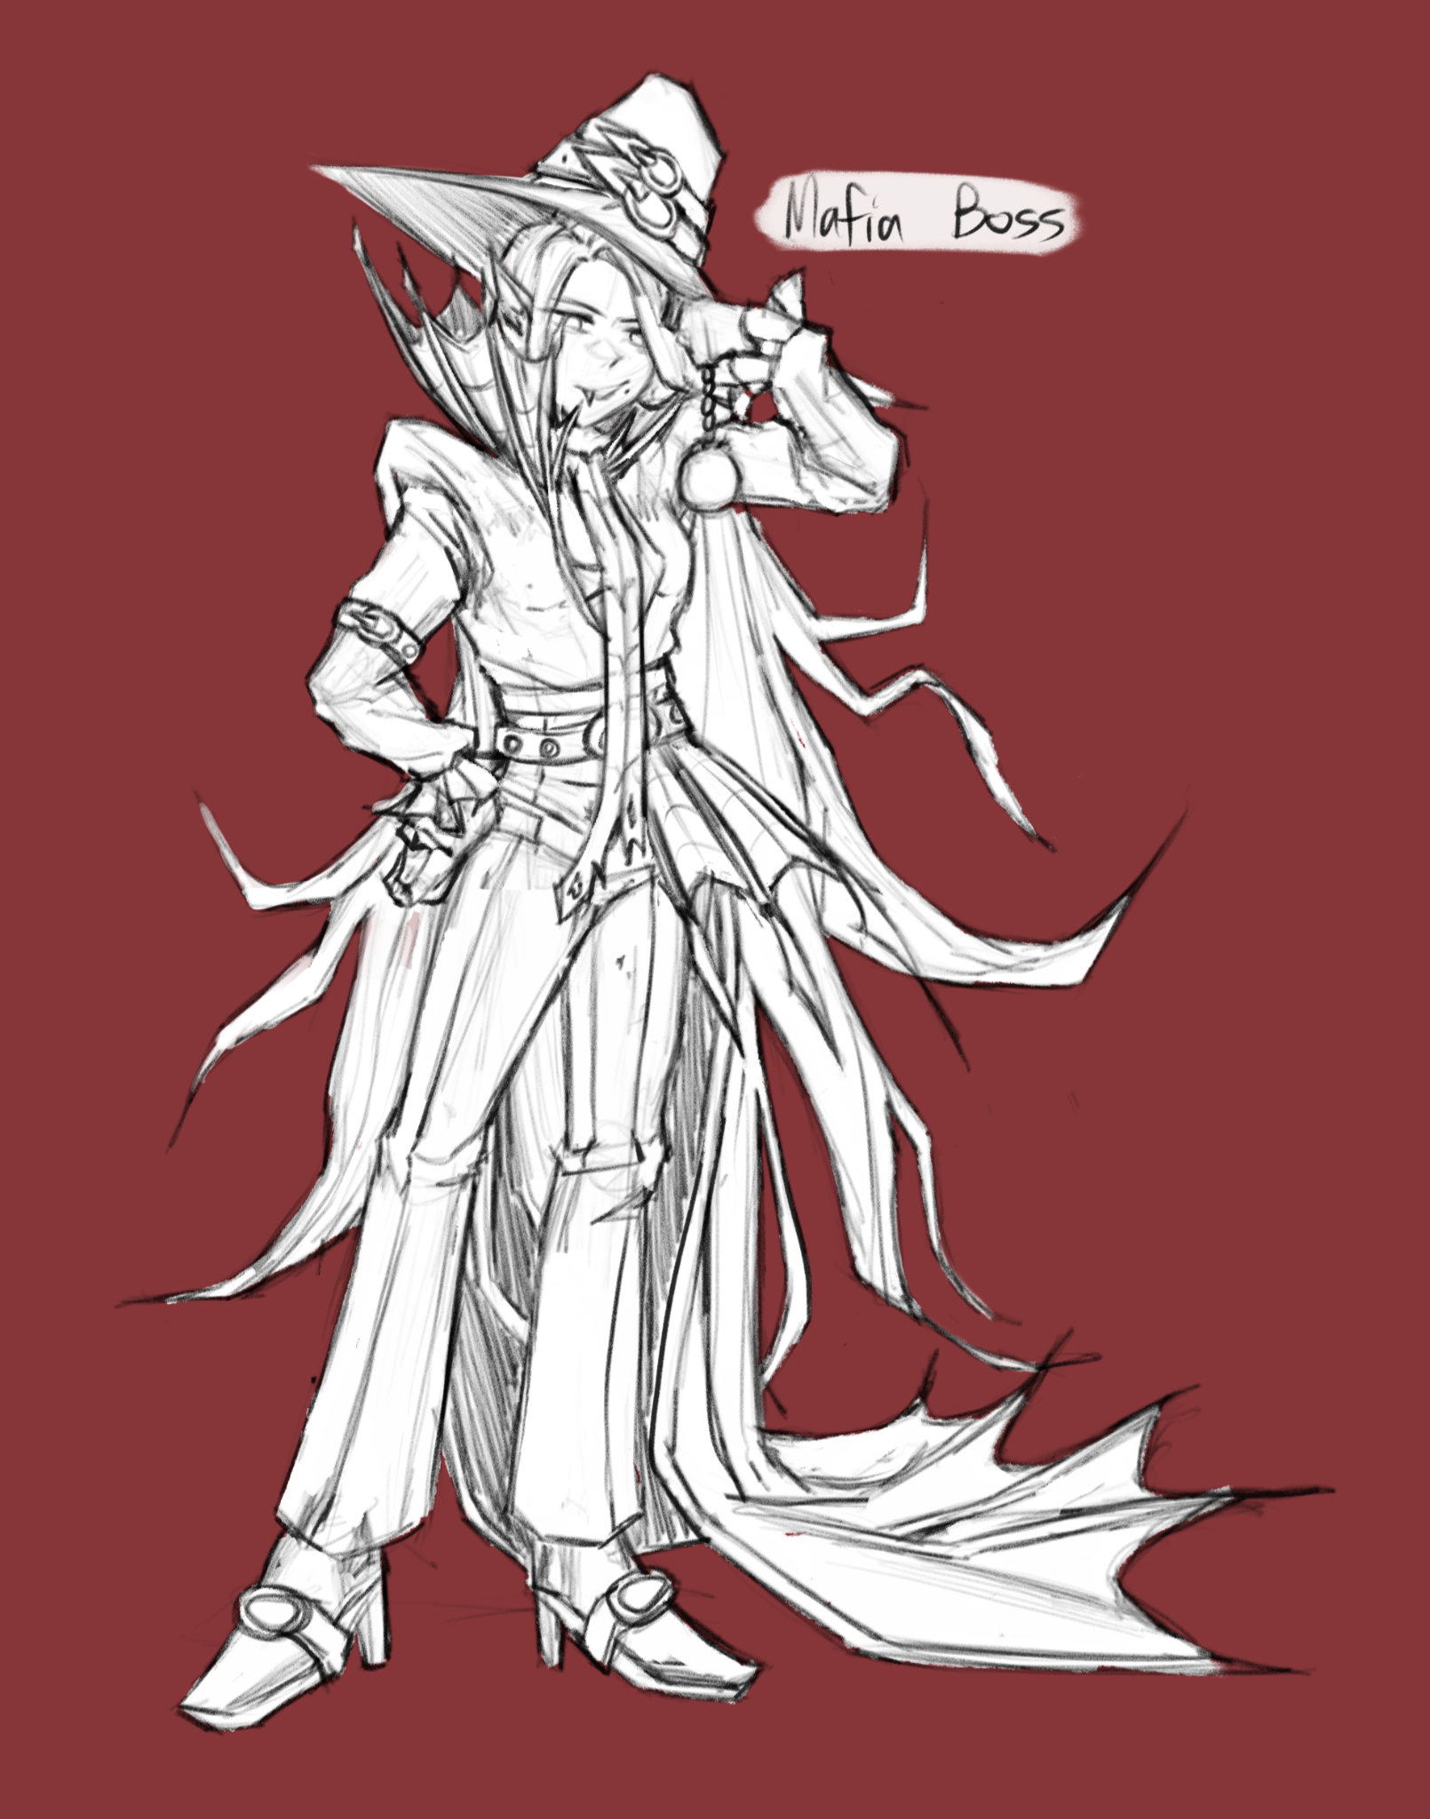
Project
DayBreak
Vampire Stealth Infiltration into the Post War Mafia
FYP By UE2

Slide 2
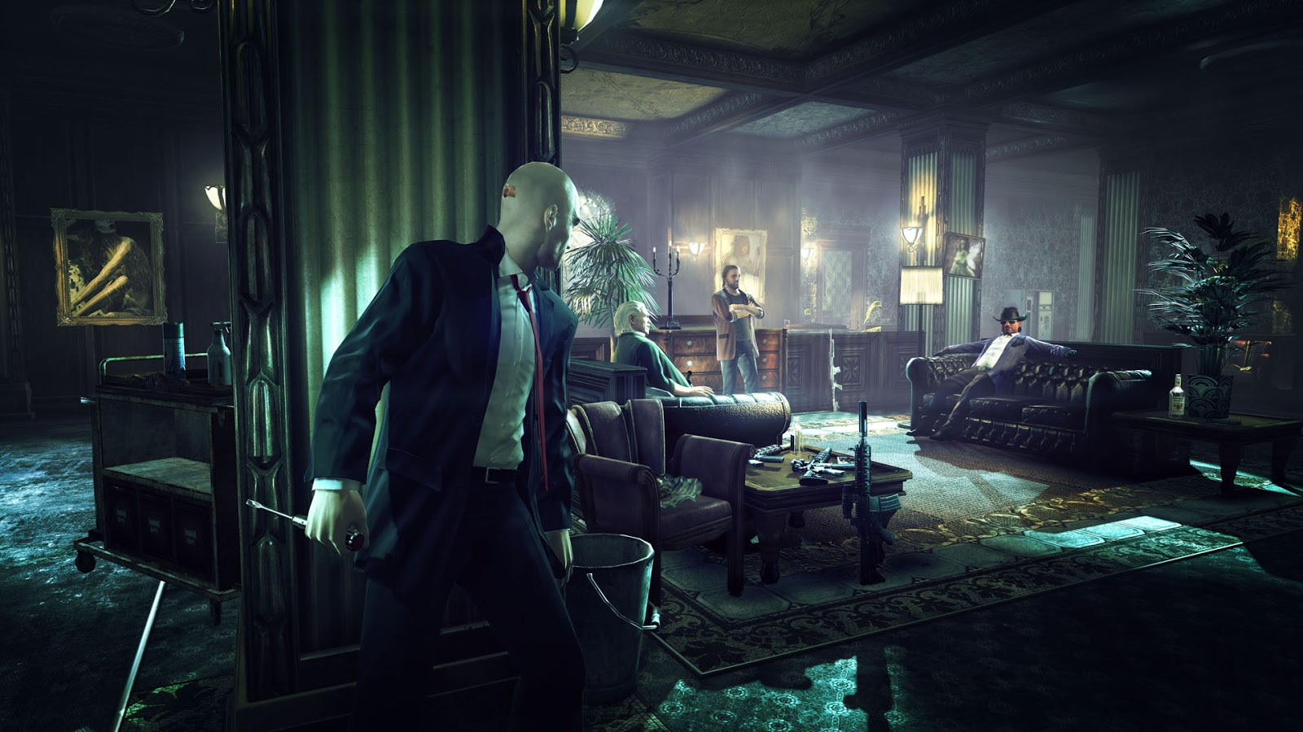
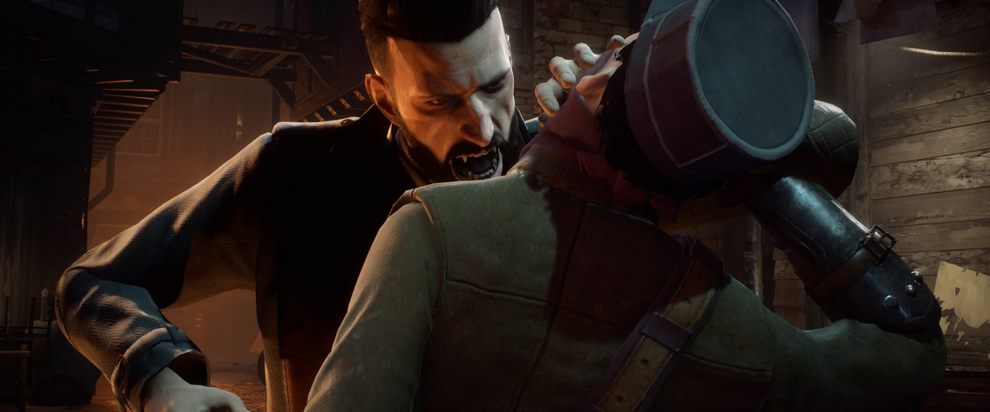
Revisit - Concept
Stealth Game + Destruction Physics
Image here
Objective-based stealth infiltration
Interactive and destructible environment
Vampire Inspired
The Ability to Teleport
Drink blood
Burn in contact with sunlight
Image here

Slide 3
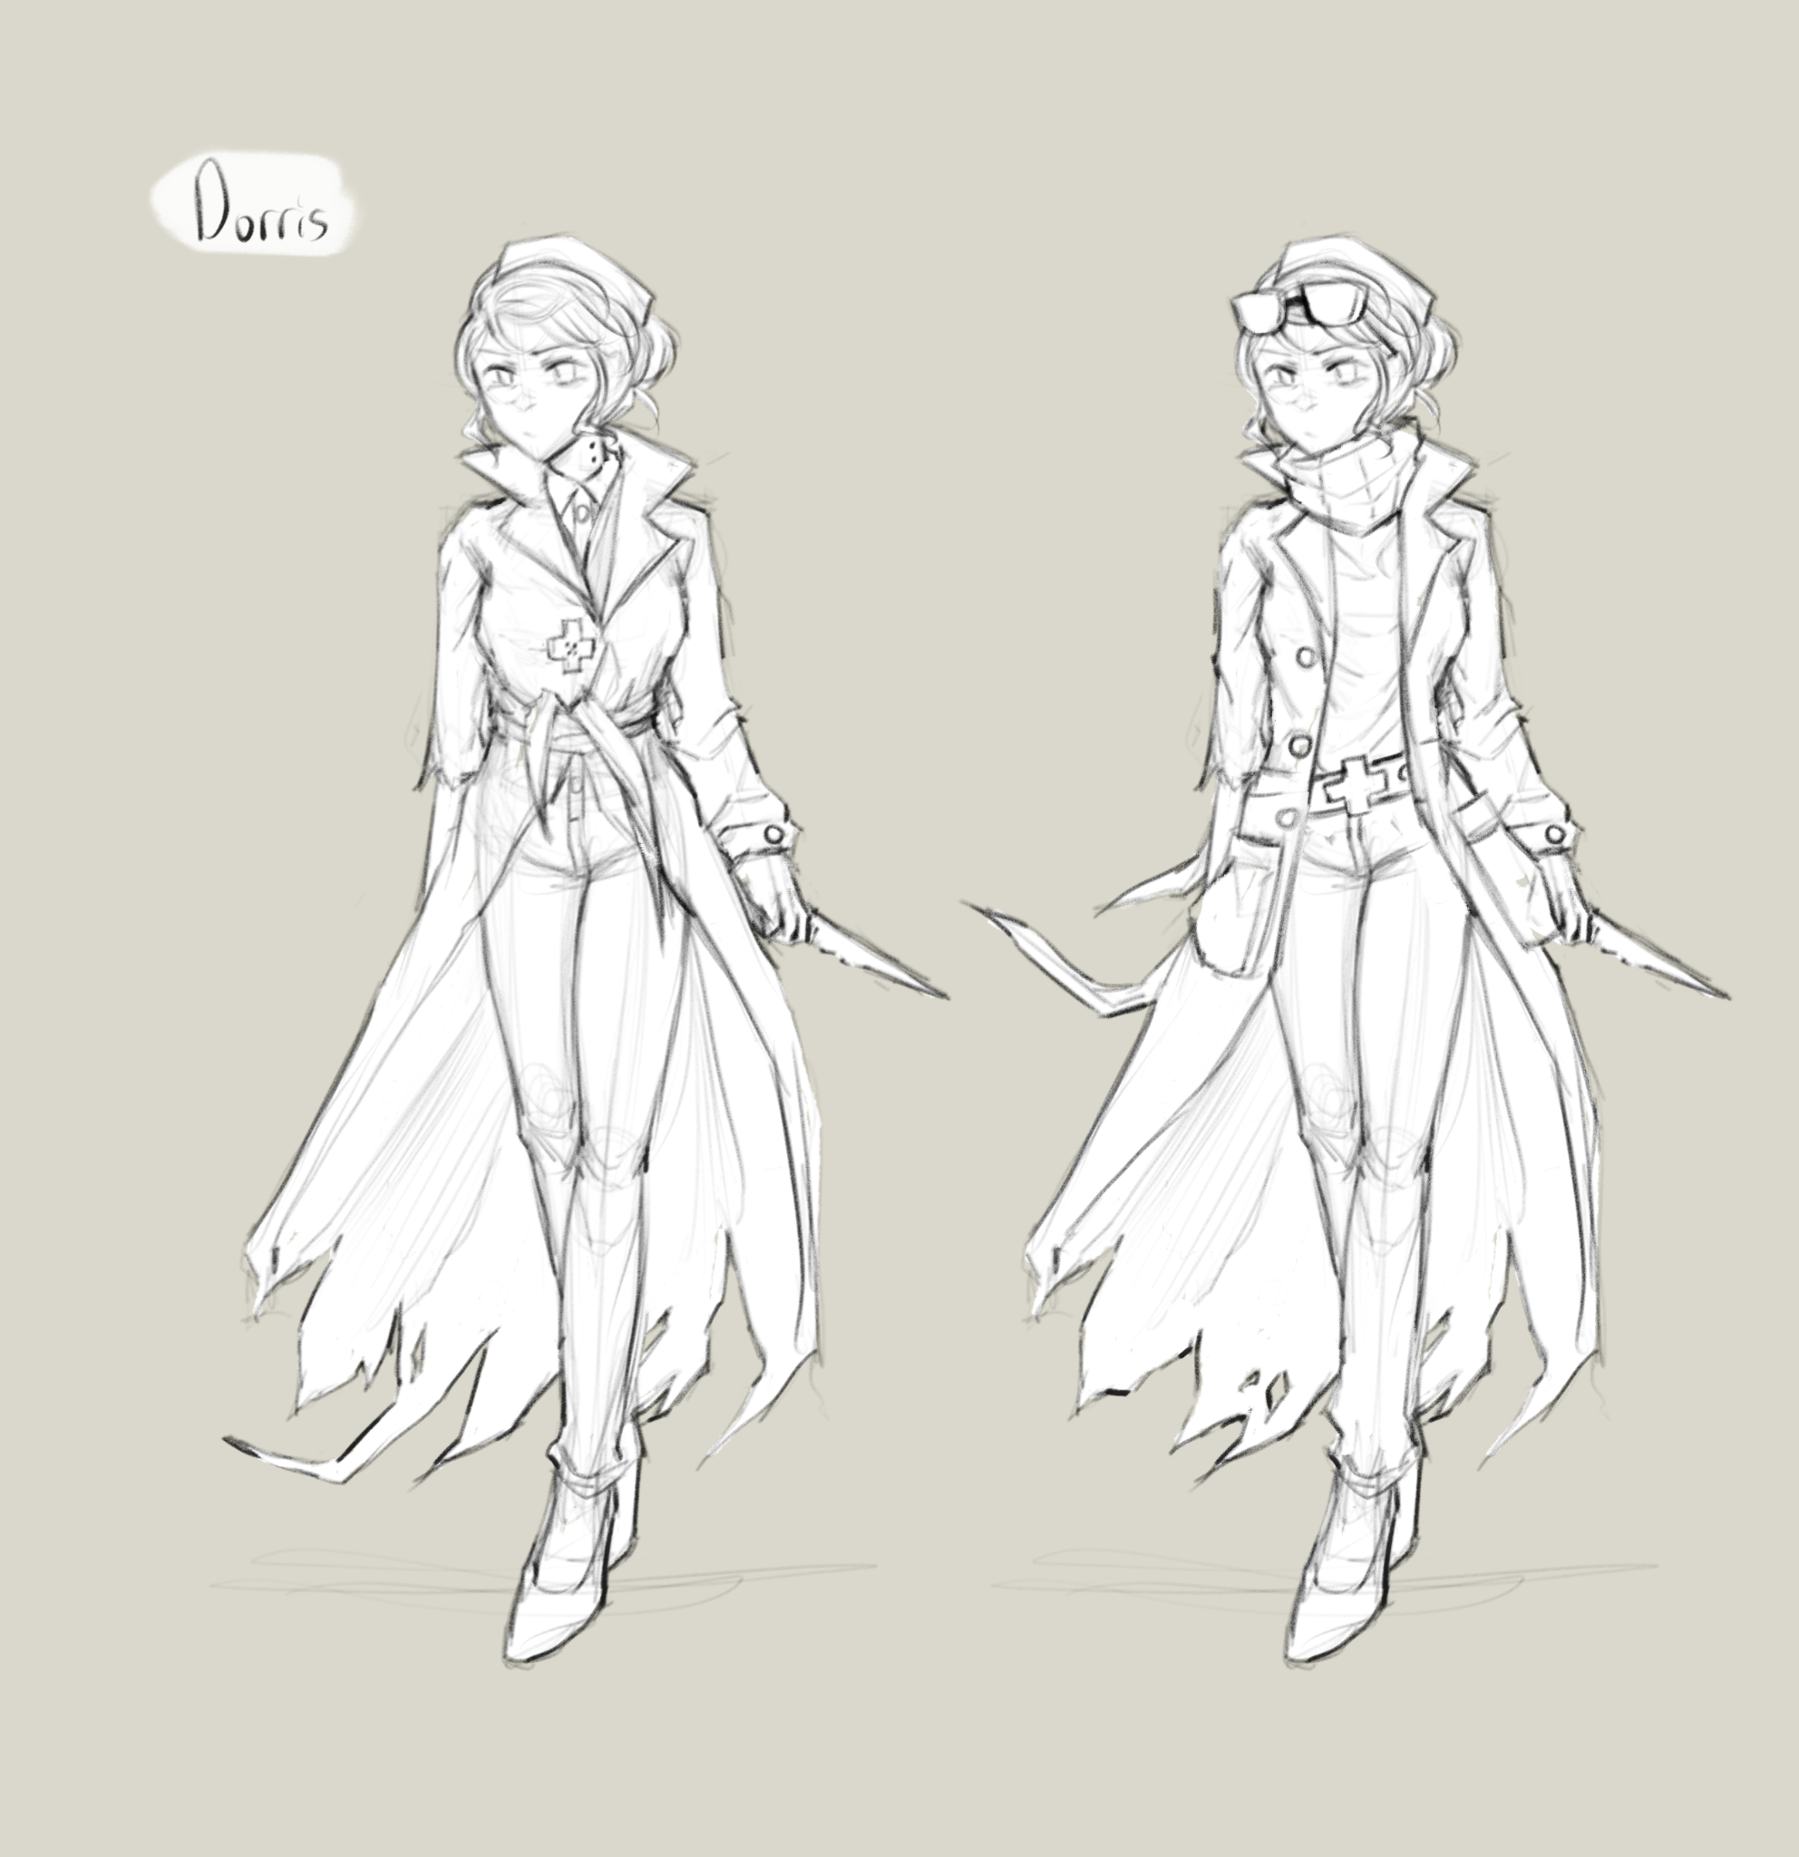
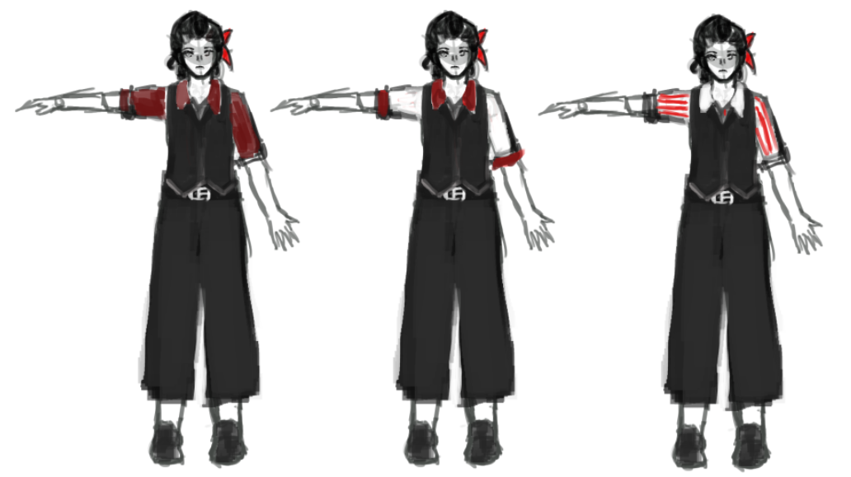
Revisit - Unique Selling Points
Realistic stealth capabilities
Vampire-inspired abilities to aid the player
Stealth game with destructible environment
Immersive play with lighting engine
Complex AI behaviour
Notes:
Realistic stealth capabilities, the player has to manage line of sight, loudness as well as visibility to avoid detection, or to distract enemies enough for them to ignore the player’s presence.
Fantasy vampire inspired abilities to aid the player
Stealth game with destructible environments, contrary to other stealth games where environment is solid and no flashy actions can destroy walls.
Immersive play on lighting engine, where the fog of war ebbs and flows to obscure the vision of the player
Complex AI behavior, they live their own lives and routines during the game’s time, where each of them has their own individual work and tasks as well as needs.

Slide 4
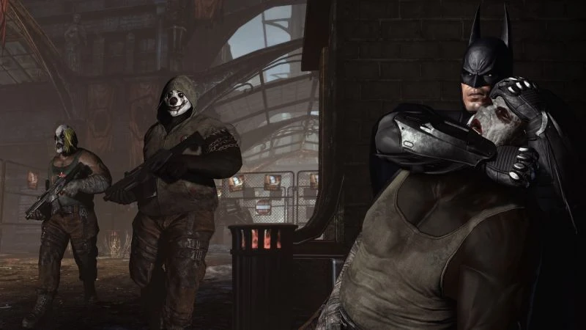
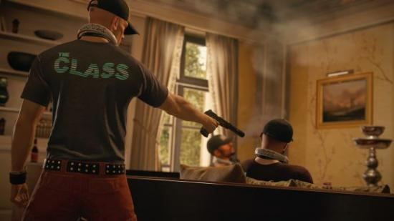
Revisit - Mechanics
Stealth
Combat
Line of sight and Directional Audio
Interactable environment
Abilities/Inventory
Fog of War

Slide 5
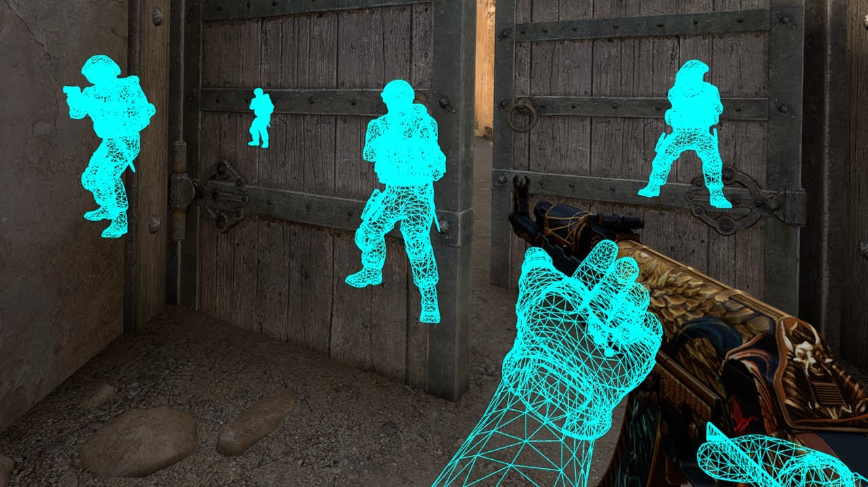
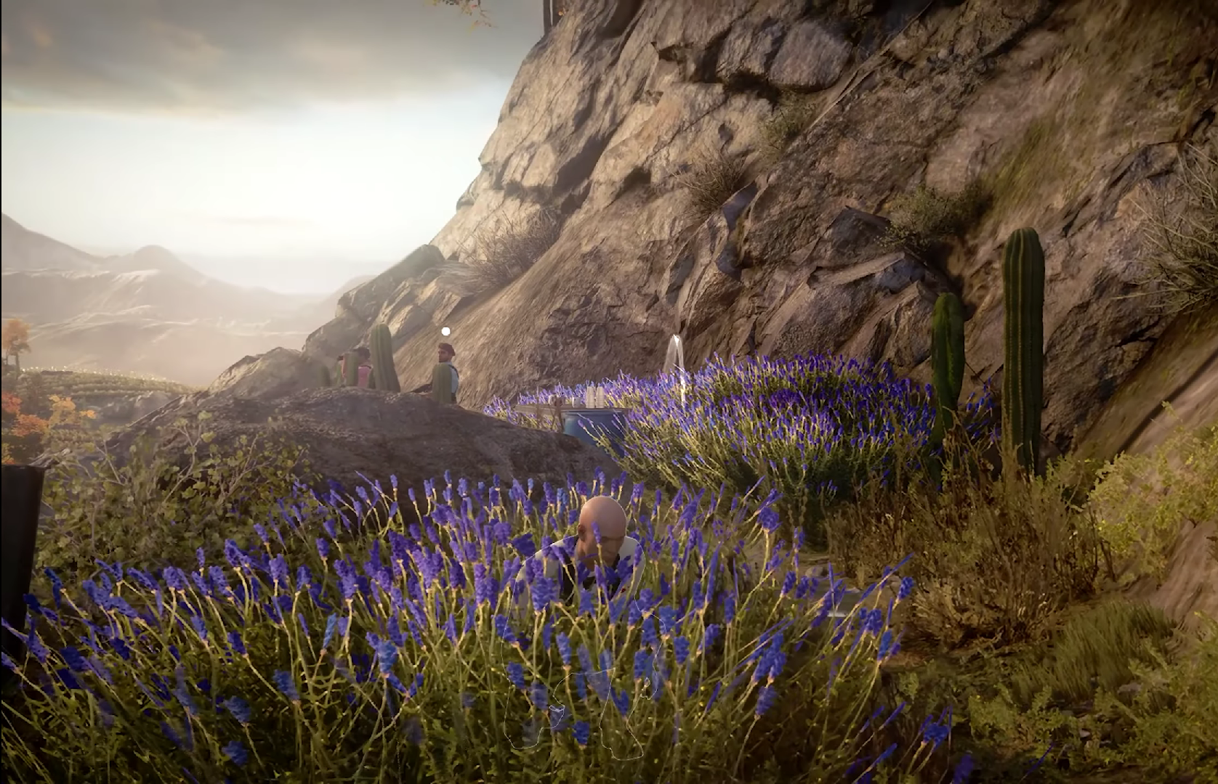
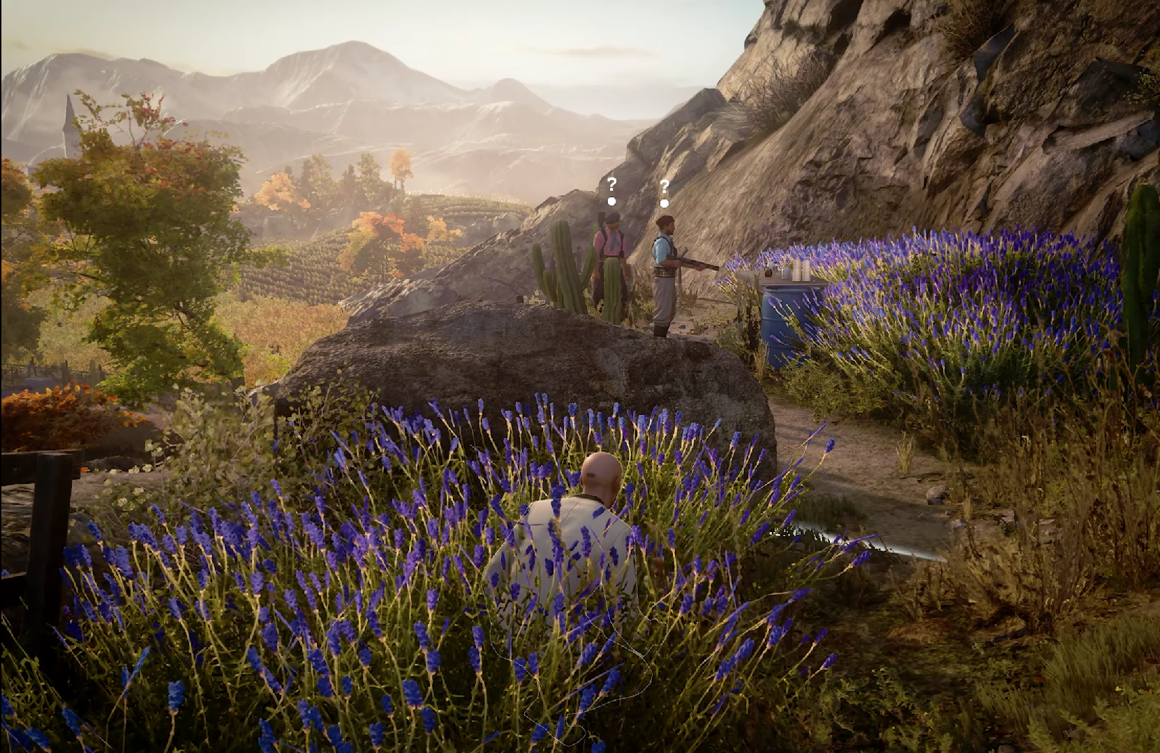
Revisit - Dynamics
Information Gathering
Redefining Space
Altering Movement
Dispatching Enemies
Enemy Manipulation

Slide 6
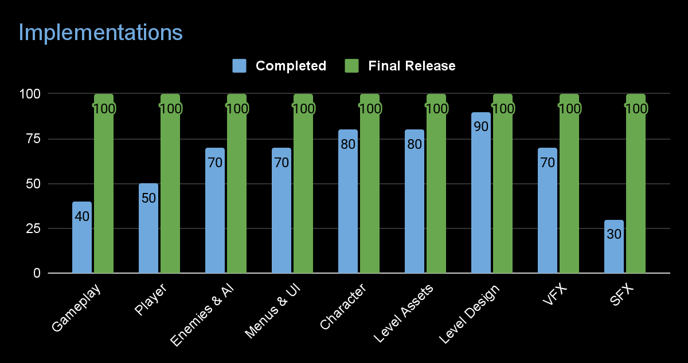

Slide 7
Demo

Slide 8
Changes Since Proposal
Reduced effect of line of sight and fog of war
Improves visibility
Better camera controls and player input context
More responsive and intuitive controls
Added subtle UI traits to reduce intrusiveness
Removed radial menu in favor is stylized grid inventory
50% discard of quick saving and loading
Time constraints makes it hard to develop

Slide 9
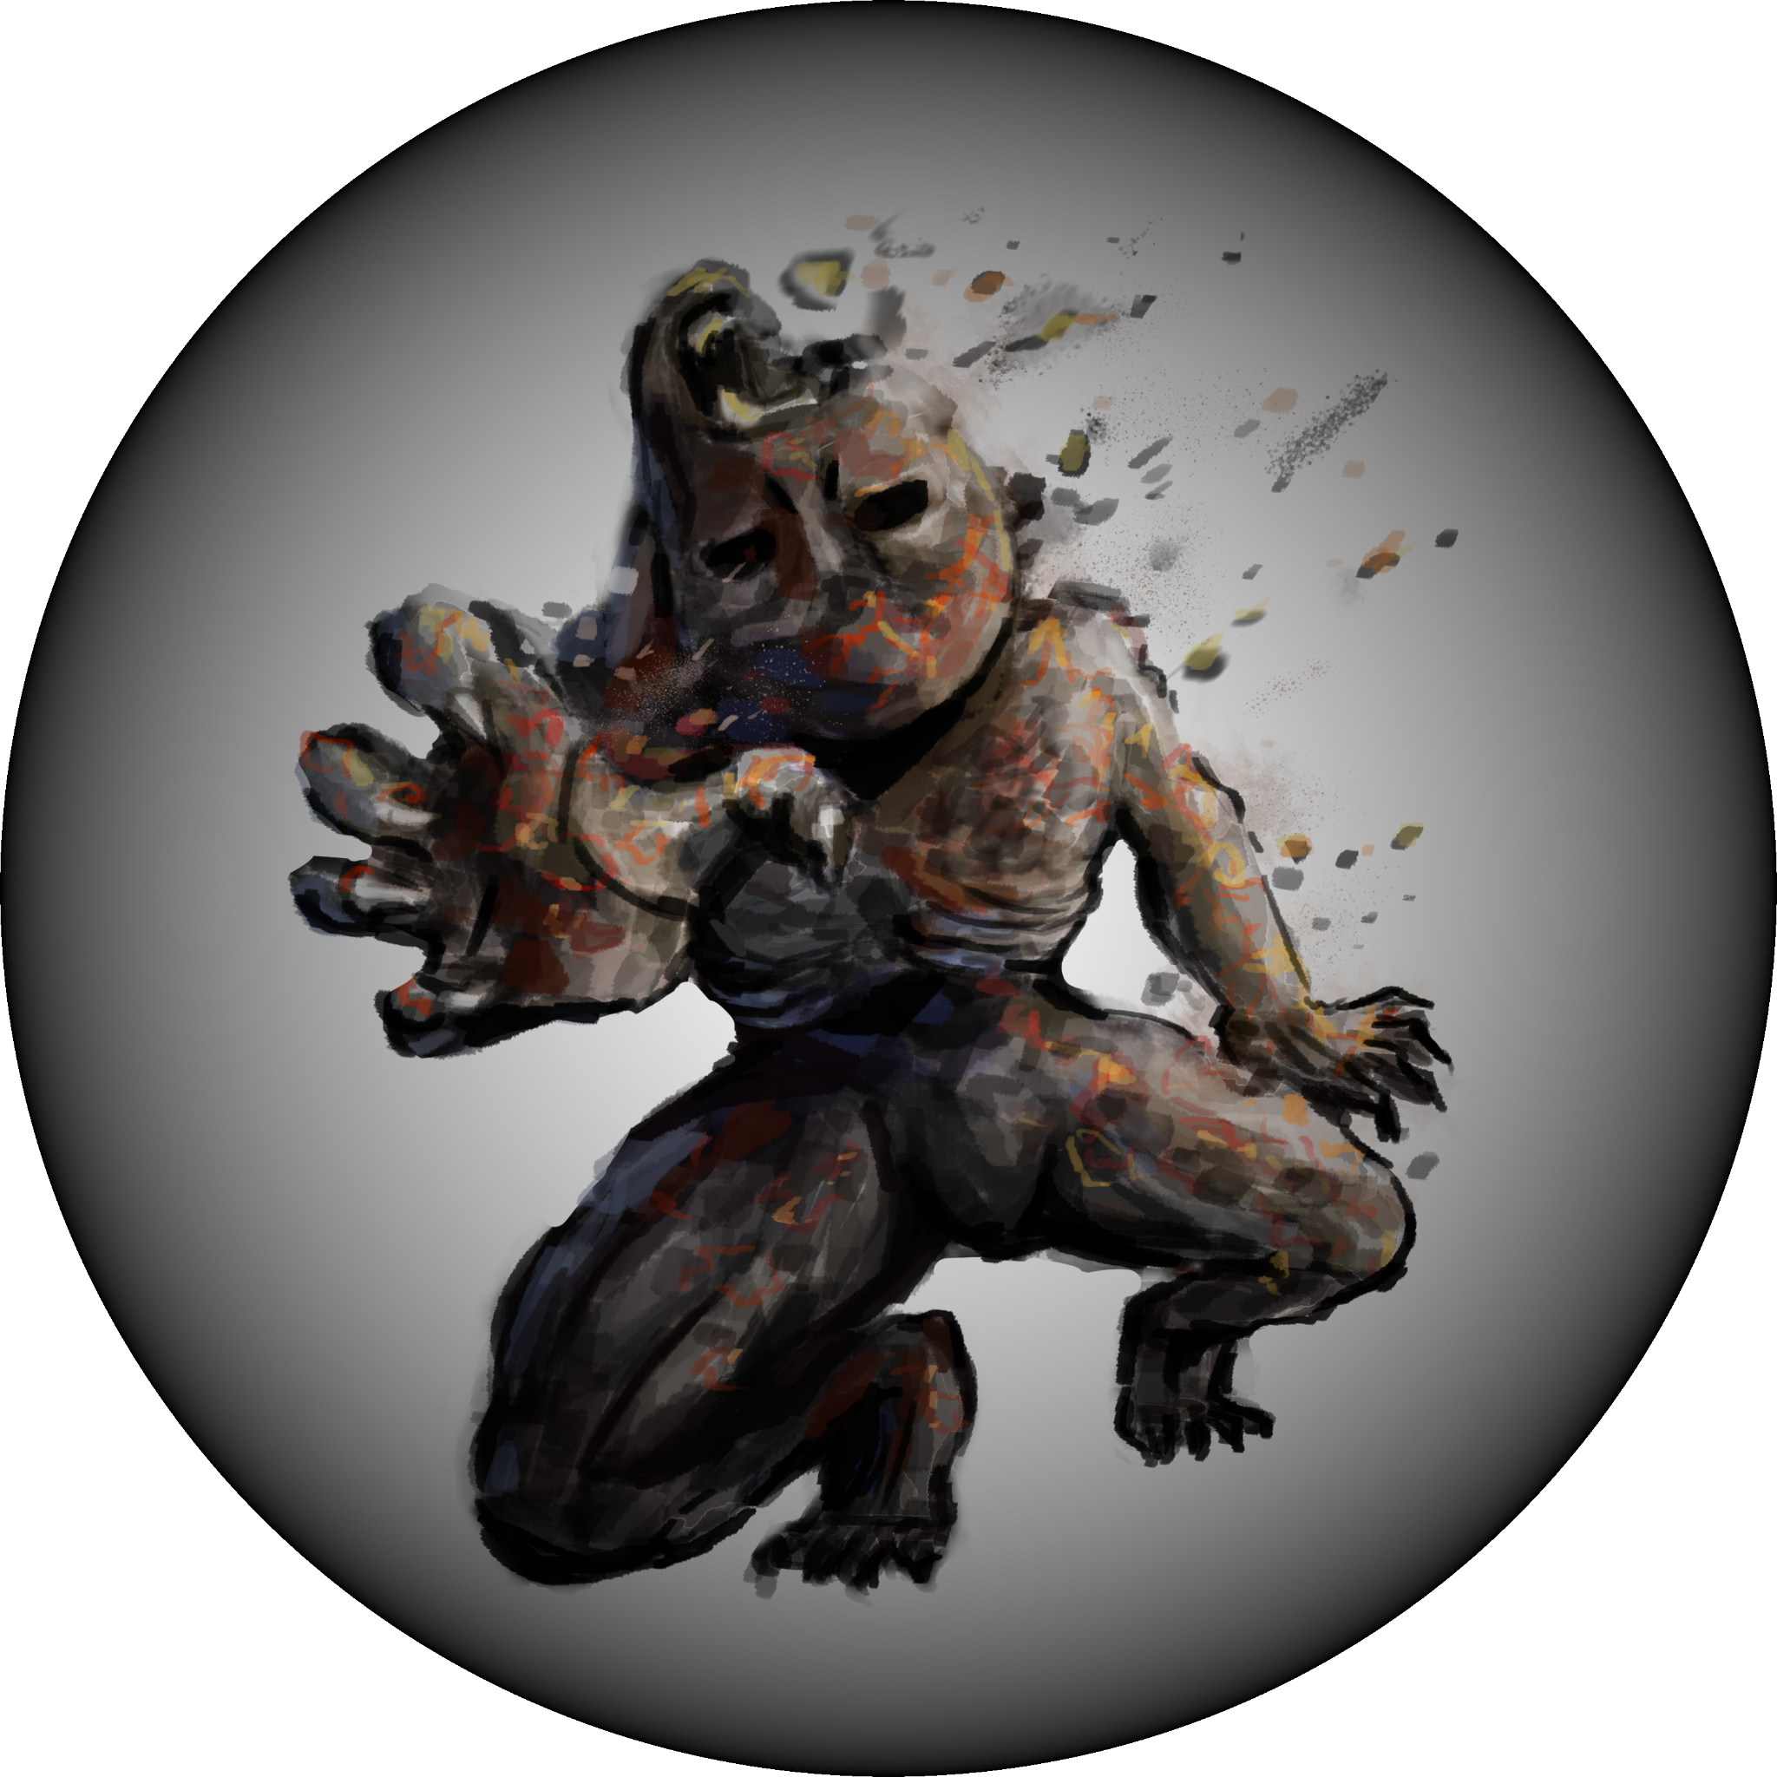
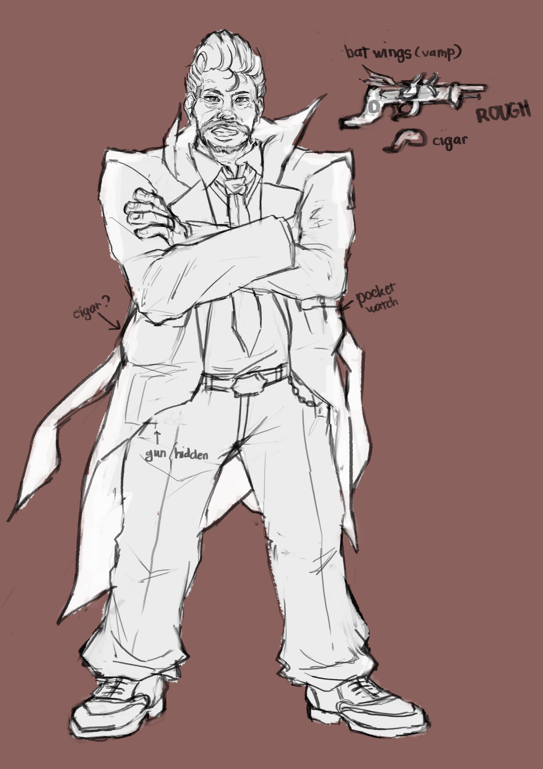
Changes Since Proposal
Improved AI behaviors with use of FSM in place of BT
Faster state changes, better reaction time
Less realistic unfortunately
Abilities & items more geared towards utility rather than combat
Enhances use of stealth rather than direct confrontation
Stealth kill and conditional events
Burning bodies for disposal
Drinking blood to regain health
Removed “Red Baron” as final boss -> concept for boss character

Slide 10
Updated Schedule
18/9
Proposal pitch
9/10
Proof of Concept/ Prototype
27/10
Playtest
17/11
Final delivery
2 weeks
Full production
3 weeks
Full production
3 weeks
Polish & playtest
Current Tasks | Inventory | Combat | Environment Assets & Lighting | Character Models and Animations
Planned Tasks | Objectives | Destructible Environment | Enhanced AI | Quick Saves and Quick Loading

Slide 11
Task List
Winston | Jiaxu | Yokawa Kazuya | Xinying | Kerrin | Others
Team Lead Tech Lead Scheduler & Task Manager | Tech Artist | Scene and Game Flow Developer | Art Lead Concept Artist | Character Concept Character Design | Concept art kindly provided by CiNing & Ysabelle
Gameplay & BackEnd Developer | Visual Effects and Particle Effects | Objectives and Score Balance | Gameplay Designer | Modelling, Rigging, Animating | Character mesh & rigging kindly fixed by Brandon
AI Interaction - Hybrid FSM with EQS | Quality Assurance Balancing | Settings and Global Session Saves | Level Design Environment Artist |  | UI design by John Player, Enemy Concept and Design
Environment & Interaction Developer |  |  | Quality Assurance Balancing

Slide 12
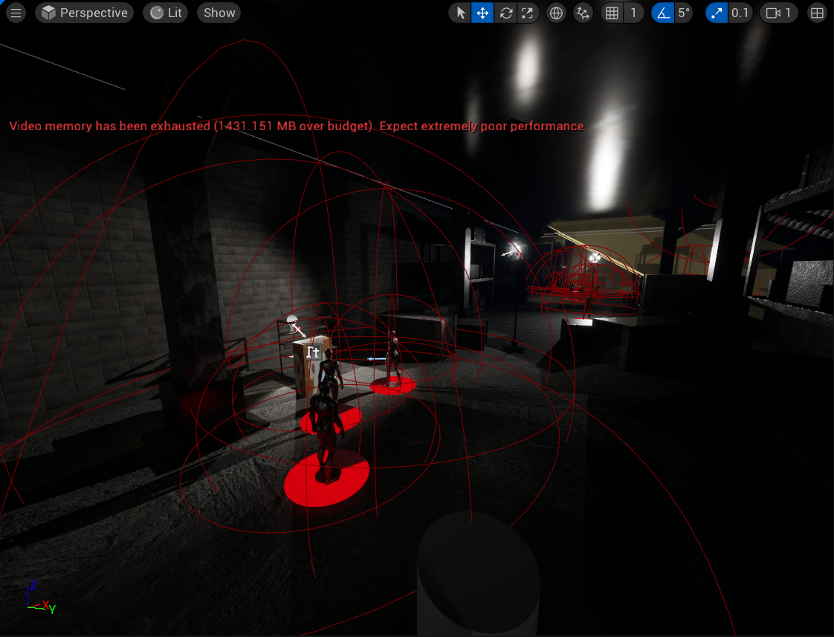
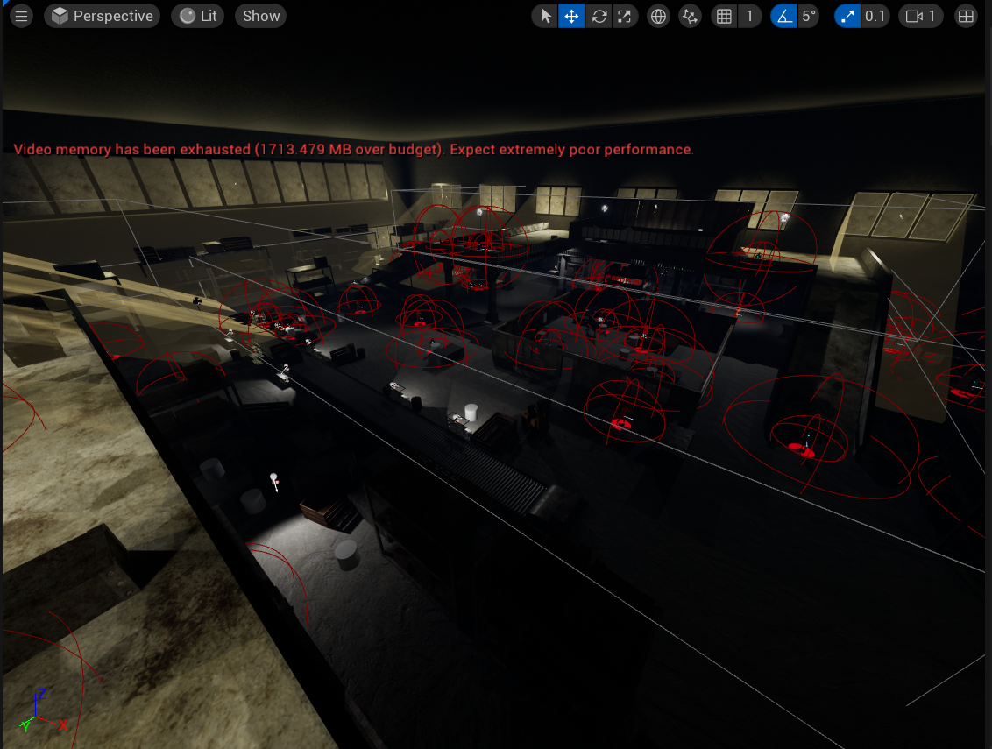
Xin Ying
Level design
Modelling and texturing of props
Gameplay Design
Player concept design

Slide 13
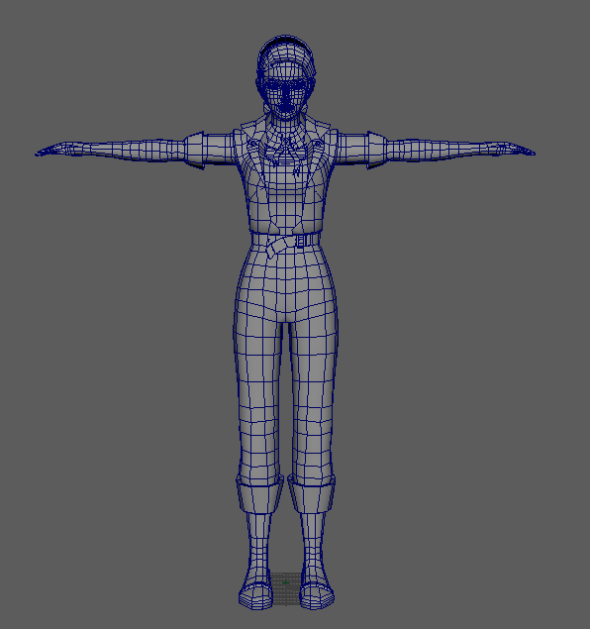
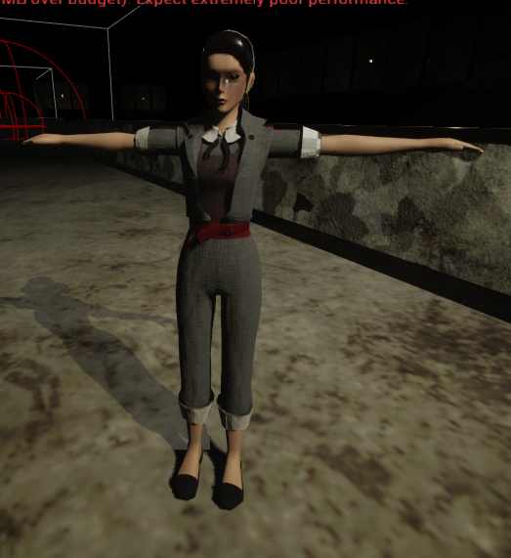
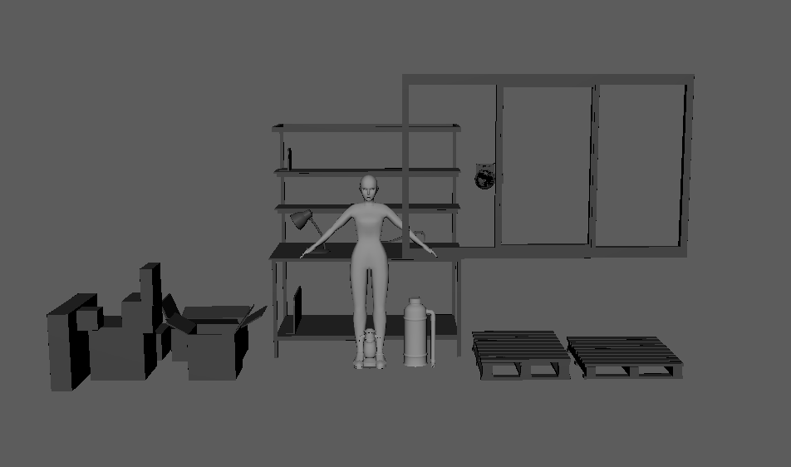
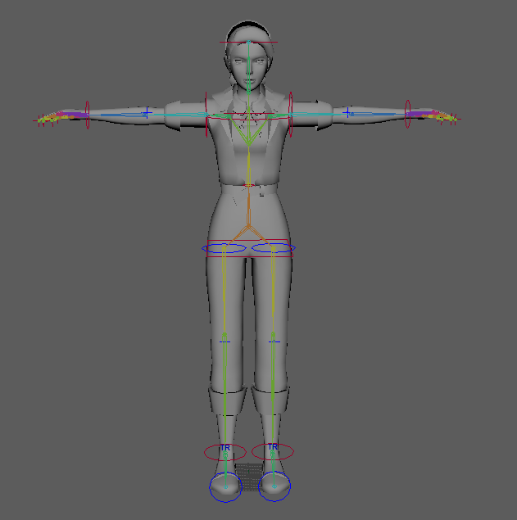
Kerrin
Player concept design
Modelling of player
Rigging and animating of player
Texturing of player
Modelling n texturing of props

Slide 14

John

Slide 15
Q & A

